Slide 1
CMU 10-742 Machine Learning in Healthcare
Lecture 2: Healthcare entities, data, and systems
Adam Berger
Notes:
Still in ‘escape velocity’ section of course

Slide 2
Course Logistics
Assignment 1 is out. No dependency on Assignment 0.
It’s not too early to start thinking about a final project - Proposal due Oct 10
Readings and questionnaires due before most lectures – check Canvas!

Slide 3
Today
Healthcare Cast of Characters
Delegated risk
Healthcare data
Phenotyping

Slide 4
Cast of Characters in Healthcare Industry

Slide 5

Government
Others
PBM
Pharma
Labs
Device mfr
CRO
Advocacy Groups
Imaging Centers
…
Health Plan
Employer
Provider
Consumer
Notes:
We’ll focus on the 5 around the pyramid. Not the only important entities. e.g. patient -> health insurer (to pay).

Slide 6
Entity | Example(s) | Money comes from | Money goes to | What do they do?
Provider
Patient
Health Plan
Employer
Government
Notes:
(fill in – volunteer)

Slide 7
Entity | Example(s) | Money comes from | Money goes to | What do they do? private
Provider | MD, nurse, home health aide, ambulance, dietitian, PT, …. | Patients (co-pay) insurer/employer |  | Deliver care
Patient | You |  | Insurer (premium) Provider (copay) | Get sick
Health plan | United Cigna Highmark | Patients (premiums) Gov’t (delegated) | Providers | Underwrite Adjudicate
Employer | CMU | Employees and affiliates | Providers and/or insurers | Subsidize/ underwrite care
Government | US federal gov’t PA | Taxpayers | Providers Health Plans | Subsidize care Regulate Deliver care
Notes:
Patient = member (depends on context)

Slide 8
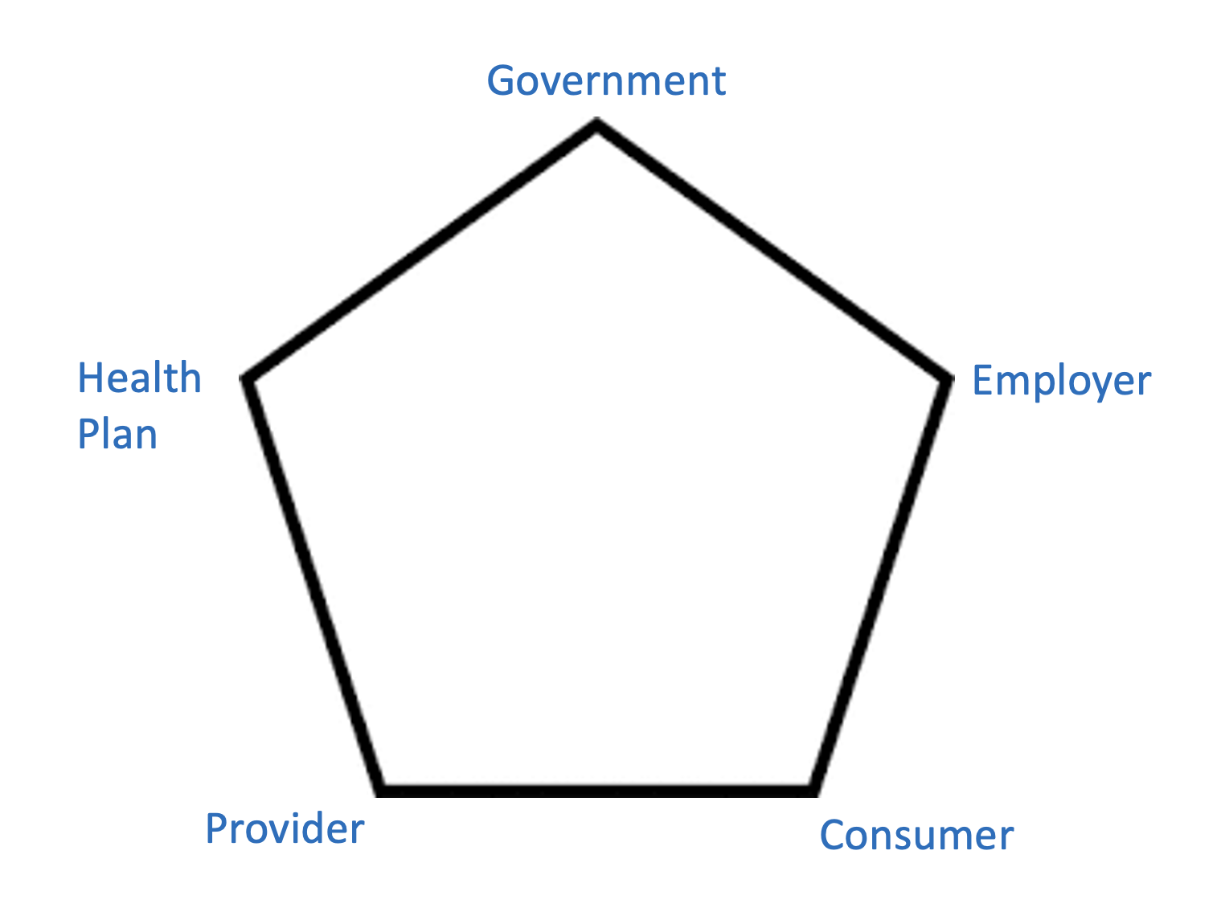
ML for Providers
CDS (lecture 12)
DX (pset 2)
Resource optimization (pset 3)
LoS prediction (pset 3)
Clinical trial matching (lecture 17)
Predicting response to therapy (lecture 18/19)
Notes:
Acronyms!
“CDS”– abbrevs in medicine
Dx = diagnosis or diabetes
LoS = length of stay
Hx = history
Px = procedure
Tx = therapy
SOB = shortness of breath
Htn
Overloaded = dx

Slide 9
ML for Payers
UM (lecture 7,8)
CM (lecture 7,8)
Automatic claims adjudication
risk stratification (lecture 3)
Formulary management (lecture 7,8)
FWA (lecture 7,8)
predict customer churn
Cost forecasting (pset 4)
Network optimization
Program evaluation (pset 4)
Notes:
Payers = [ health plan, gov’t, employer]
Why are we clustering these 3 entities? In many respects they have common incentives – all primarily pay for healthcare (vs. deliver or consume)

Slide 10
Today
Healthcare Cast of Characters
Delegated risk
Healthcare data
Phenotyping

Slide 11
Delegated Risk
Government
Health Plan
Employer
Provider
Consumer
Notes:
Go back to our pentagon
We need to understand delegated risk
Simple everyday examples:
Car insurance: I’m delegating full risk to insurer. Deductible – they delegate some risk back to me.
Home warranty: I’m delegating risk to American Home Shield.
healthplan>Provider: ACO
Gov’t -> Insurer: MA
Employer -> Health plan (small employers) -> consumer (deductible)
Financial risk as a hot potato

Slide 12

Example: “Privatizing” Medicare
“Original” Medicare
1965: Medicare introduced. Available to all 65+ in U.S.
U.S. Gov’t is the insurer.
Medicare Advantage (2006)
Private health plans can offer insurance to Medicare recipients.
CMS pays the health plan to insure the patient.
~50% of Medicare recipients are in an MA plan.
Notes:
One example of delegated risk

Slide 13
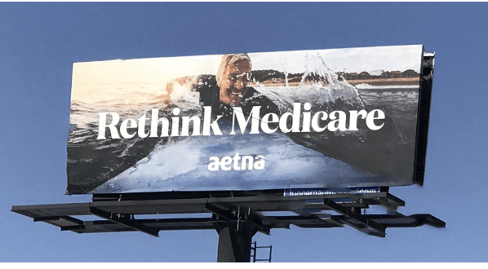
Notes:
Annual enrollment period oct-dec

Slide 14
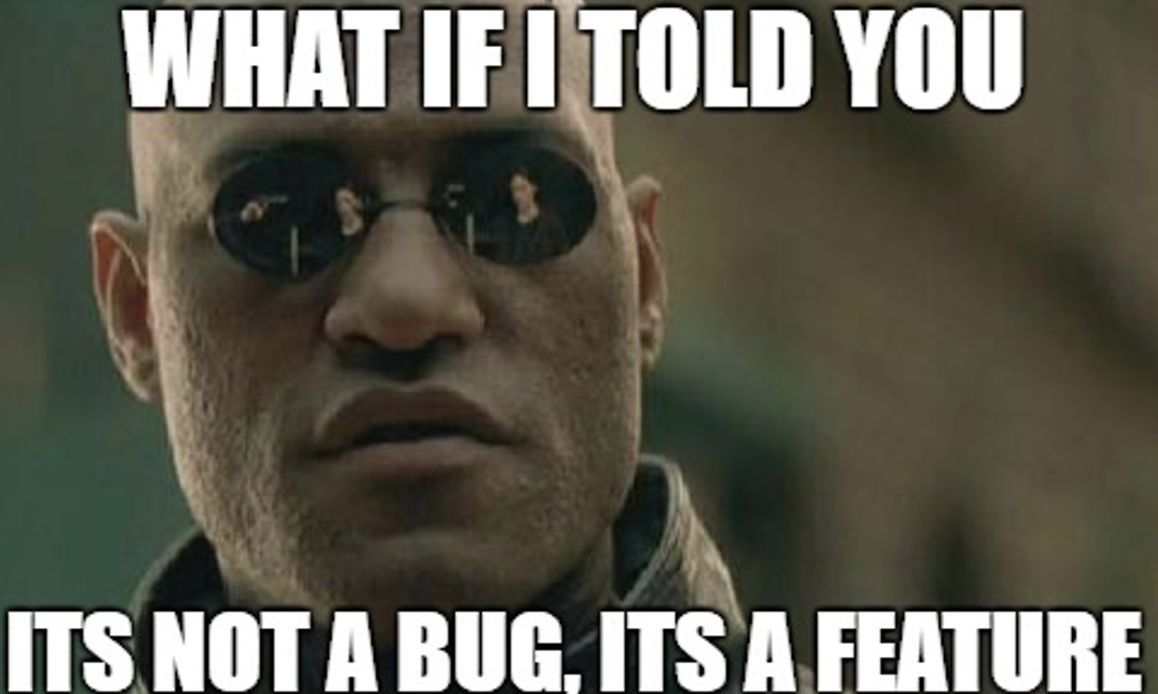
Notes:
Who invests in long term outcomes? Insurer? Employer? Health system?
Systemic flaw. Single payer doesn’t have this problem

Slide 15
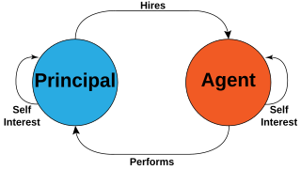
Principal-Agent Problems in Healthcare
https://en.wikipedia.org/wiki/Principal%E2%80%93agent_problem
Notes:
“Principal agent problem” – fancy term for when one party delegates work to another party, but their incentives aren’t aligned.
Examples?
1. Consumers ”hire” health insurers to cover their healthcare costs. Then those insurers apply UM to deny care.
2. Insurers pay providers to deliver care to their patients. Are their incentives the same? Providers want to treat patients and maximize earnings – not save $$.
3. Patients pay employers (through reduced wages) to cover their healthcare costs. Are there incentives the same?

Slide 16
Today
Healthcare Cast of Characters
Delegated risk
Healthcare data
Phenotyping
Notes:
We are ML practitioners, and we deal in data.
Where does MLH data come from and what does it look like?

Slide 17
Type | Source | What it represents
EHR
Claims
Images
Genomic
Monitoring devices
Patient-reported
Notes:
We touched on this Tues, now digging in.
What healthcare data sources didn’t I list here?

Slide 18
Type | Source | What it represents
EHR | Hospital | Demographics, problems, allergies, meds, procedures, immunizations (“PAMPI”), diagnoses, lab results. Clinical notes, discharge summaries.
Claims | Health Plan | dx, px, rx, costs
Images | Rad, derm, ophtho, cardio | X-rays, CT scans, MRIs, ultrasounds. DICOM and related formats.
Genomic | Various | DNA sequencing data SNP data Gene expression data
Monitoring devices | (Patient or hospital) Holter, CGM, fetal monitors, BP monitors, sleep apnea monitors | Continuous stream of data over time
Patient-reported | Hospital, 3rd party | Surveys, questionnaires

Slide 19
Healthcare Codesets: What and Why
Notes:
Let’s motivate this
ICD: Last week – child abuse CDS triggered by dizziness or unexplained bruises. How to build?
ICD: Epidemiologic researcher wants to know how many cases of strep throat among children in PA in 2023
CPT: CMS processes > 1B medical claims annually. How to decide what to pay for each encounter?
DRG: patient comes into the hospital with an MI and is treated, imaging, statins, then released. How much does Cigna pay the hospital?

Slide 20
Common Codesets
Codeset | Description | Example
ICD | “Diagnosis code” (what the patient has) | E11.9 Type 2 diabetes mellitus without complications
CPT | “billing code” (what provider did for the patient) | 99213 Office visit for an established patient
DRG | “Inpatient code” (what kind of hospital stay this was) | DRG 470 major joint replacement w/o complications
Notes:
There’s data sources and then there’s how you encode that data
Many, many more codesets: LOINC, SNOMED, RXNORM, NDC, …
Why all 3? (why not just 1 baseball statistic?)

Slide 21
Jill, a 65-year-old woman, comes to the emergency room with difficulty breathing and chest pain. She’s diagnosed with pneumonia and admitted to the hospital for treatment. At the hospital, she gets a chest x-ray.
ICD Code:
CPT Code:
DRG Code:
Notes:
ICD: J15.9 (Unspecified bacterial pneumonia) and R07.9 (Chest pain, unspecified)
CPT: 99285 (Emergency department visit, high complexity), 71045 (X-ray exam of chest, single view)
DRG: 193 (Simple Pneumonia and Pleurisy without CC/MCC)
LOTS of AI-powered coding solutions out there. An open, active areas of research. 1000’s of human coders in Phillipines, etc.

Slide 22
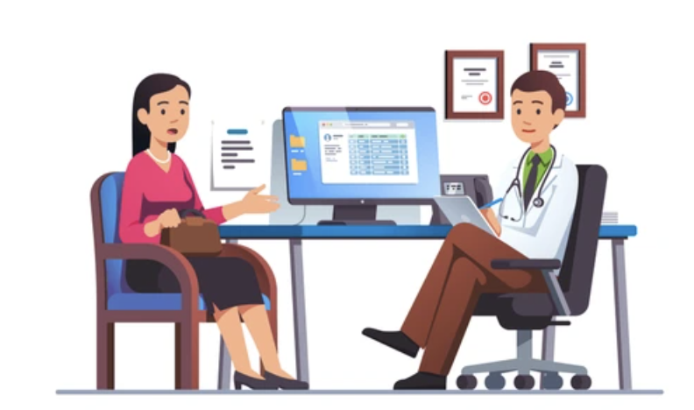

Who Codes? Where? Why?
1. Providers delivering care to a patient
2. Medical coders preparing to submit claim to insurer
Goal: accurately document patient’s condition, treatment, and procedures. Make it easy for the next clinician who treats this patient. Facilitate reporting, quality control, and research.
Goal: get paid correctly, promptly, and maximally.
Notes:
For a given encounter, may not be the same output
Sometimes one and the same

Slide 23
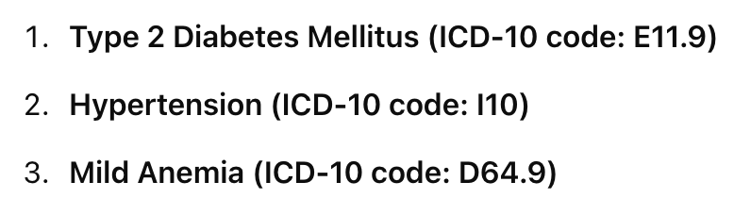
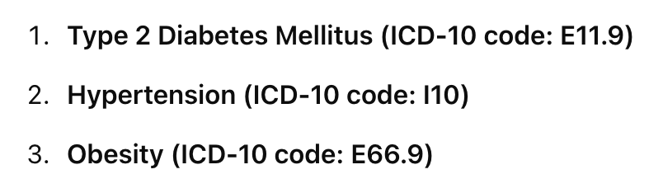
Coding Output Often Diverges
Scenario: Jeffrey visits Dr. Cruz for an appointment. Jeffrey has Type 2 Diabetes and Hypertension. During the visit, Jeff also mentions that he’s been fatigued lately. Dr. Cruz diagnoses Jeffrey with Mild Anemia. Dr. Cruz also notices that Jeffrey’s Body Mass Index (BMI) is elevated.
Dr. Cruz uses these codes in the EHR:
Medical coder uses these codes in the claim:
Didn’t bother adding obesity – not the primary focus of visit.
Didn’t bother adding anemia – it was not related to any care delivered during visit. Did add obesity - Including this diagnosis can potentially justify a higher level of care and support the complexity of the case

Slide 24

Notes:
‘fresher’

Slide 25
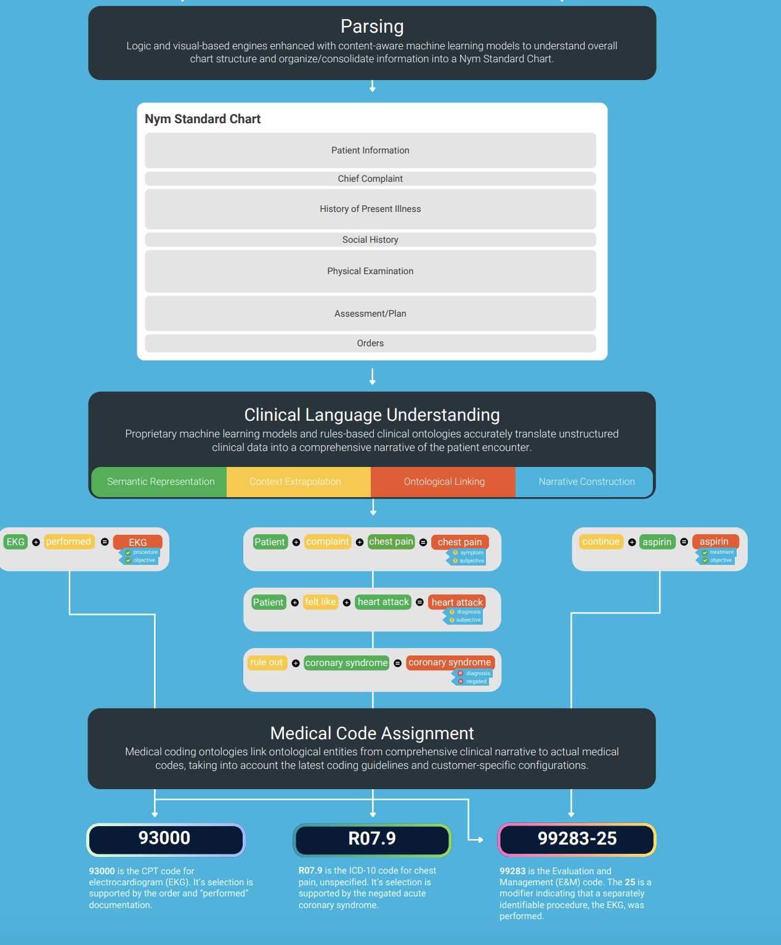
AI-Powered Coding
“Computer-Assisted Coding” or “CAD”
https://aviaconnectcontent.s3.amazonaws.com/f68a2971-5112-4581-8c9d-666d2b18b185
Notes:
Many variants but here’s one very relevant one.

Slide 26
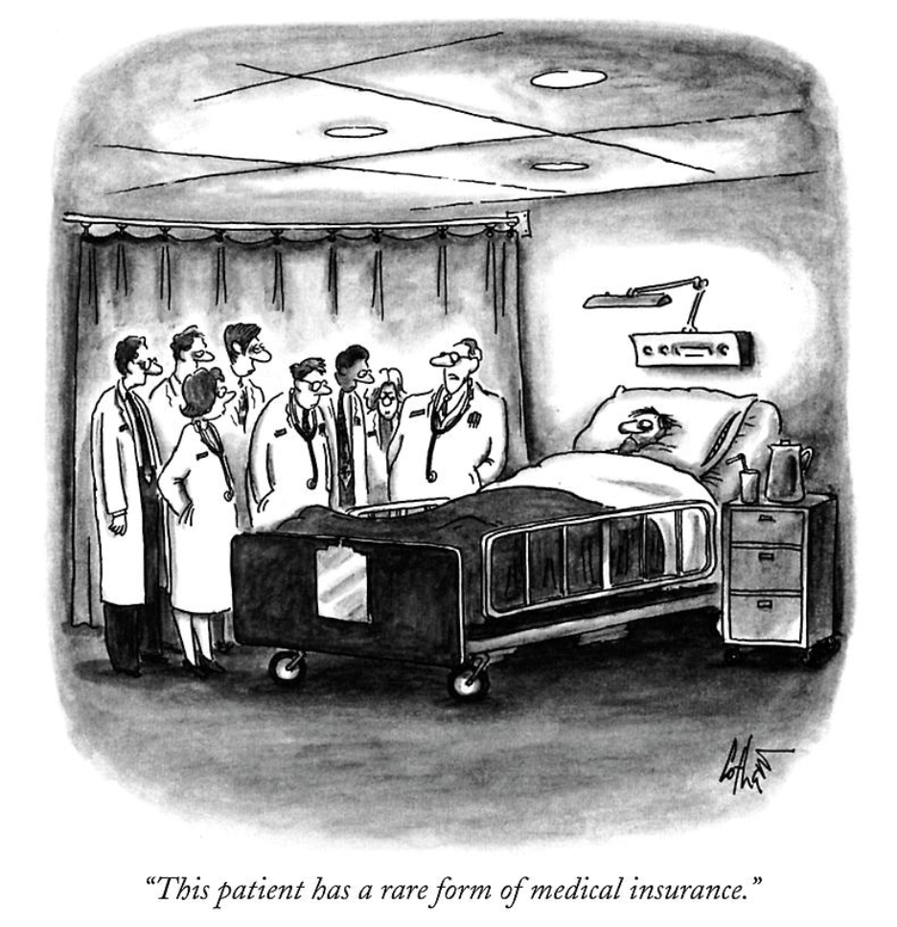
Halftime

Slide 27
Today
Healthcare Cast of Characters
Delegated risk
Healthcare data
Phenotyping

Slide 28
Phenotype: the observable characteristics of an organism
eye color, height, skin color, lactose intolerance, “has cystic fibrosis”, flower shape,
The term is overloaded in medicine to mean “a clinical feature of an organism”
Notes:
Phenotype examples?
In medicine, ‘phenotype’ is overloaded to mean ‘a clinical feature’

Slide 29
Example Phenotype Definition: Type-2 Diabetes
Diagnosis Codes: Presence of ICD-10 code E11.x OR
Lab Results: Two or more HbA1c levels ≥ 6.5%.
OR
Medications: rx for metformin or other diabetes medication
Notes:
If you were within a health system and had access to all the clinical data, how might you do this?

Slide 30

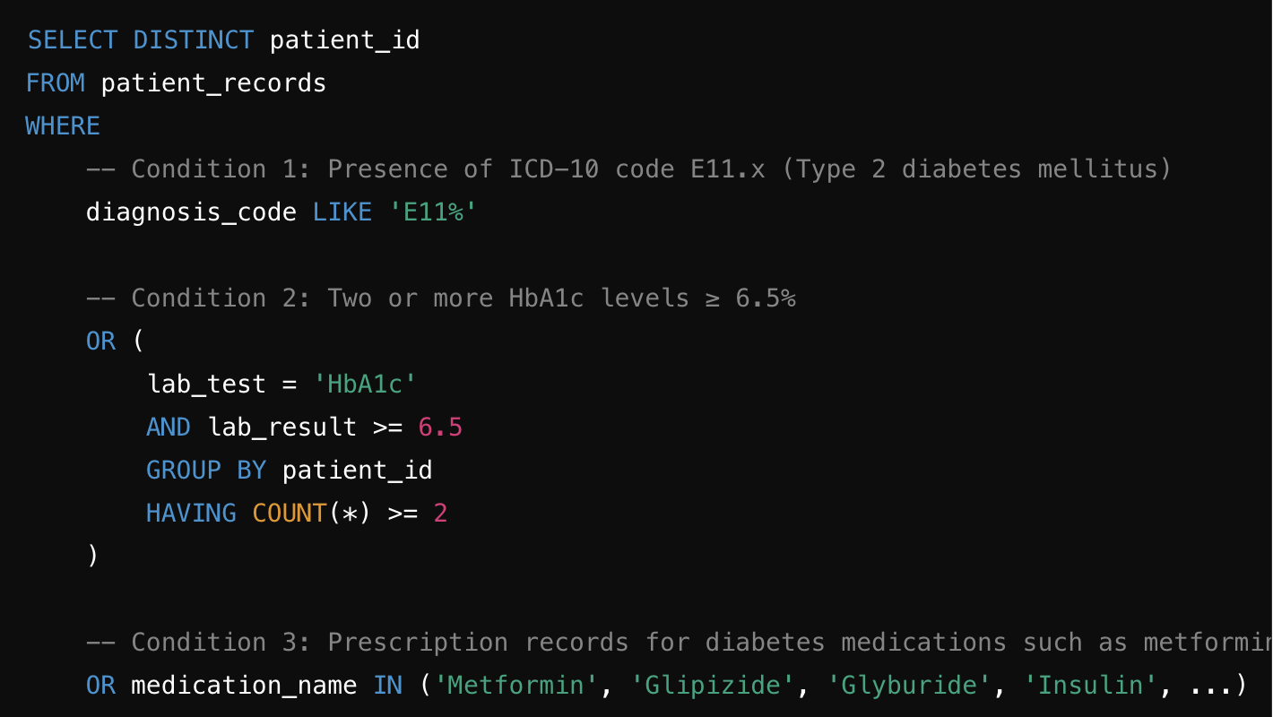
Notes:
That’s easily converted to a SQL query.
What’s the issue?

Slide 31
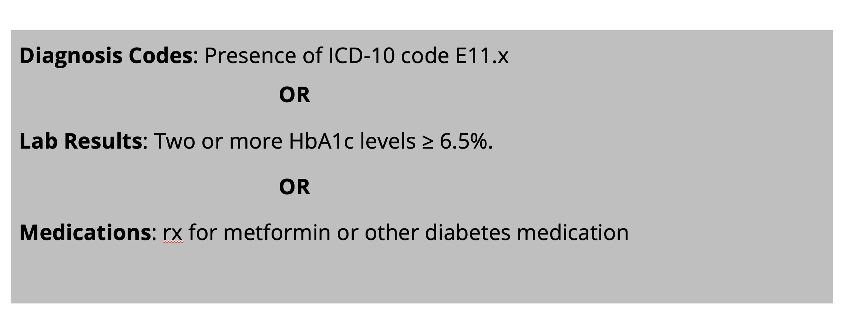
But wait
Notes:
Go back to the definition. What’s wrong with it?
metformin also prescribed for other conditions
HbA1C not always tracked
ICD codes not always documented

Slide 32
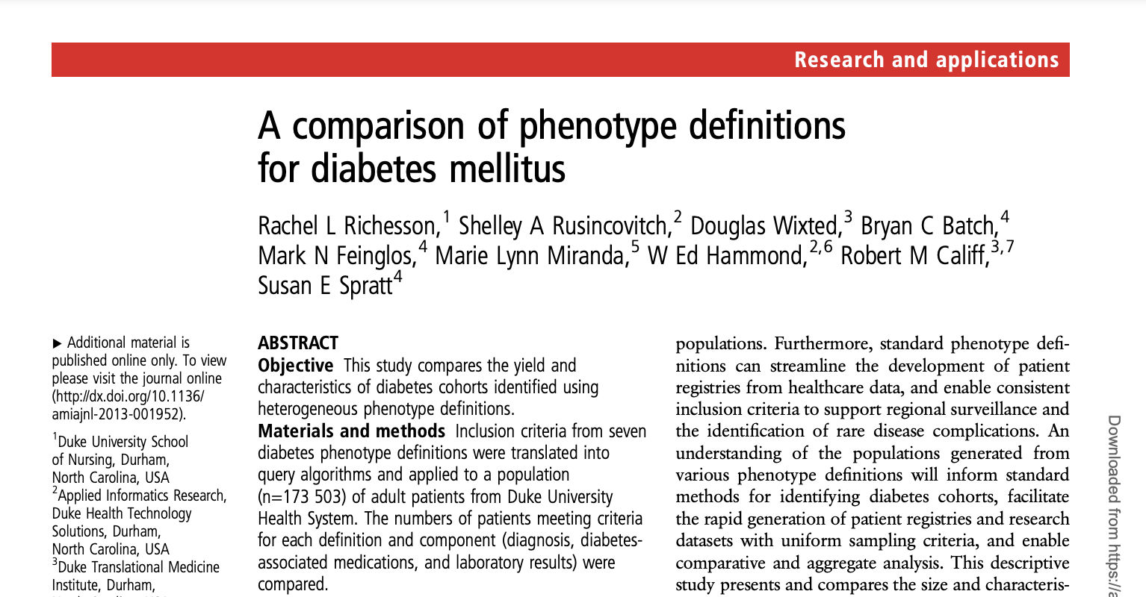
https://www.ncbi.nlm.nih.gov/pmc/articles/PMC3932460/pdf/amiajnl-2013-001935.pdf
Notes:
One of MANY papers on diabetes phenotyping
Thousands on phenotyping generally
Analogy: “find me all students at CMU who are good at machine learning”

Slide 33
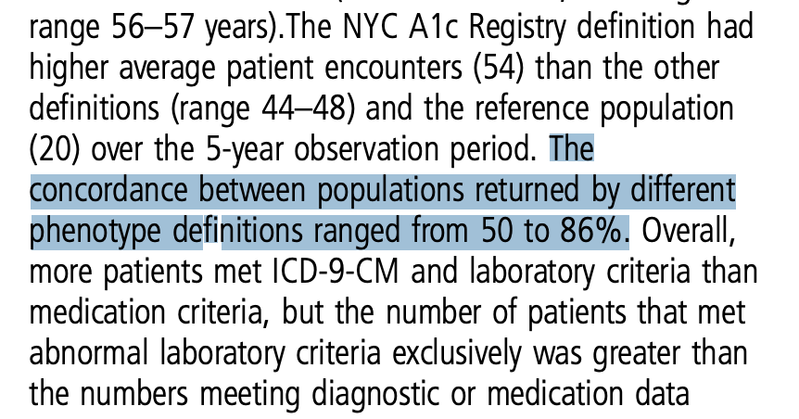

Slide 34
Another Example…
Phenotype: Patient suffers from depression.
There’s ICD codes (F.32.x), but the condition is underreported. Common medications for depression (e.g., SSRIs, SNRIs) are also prescribed for other conditions.
Notes:
Bottom line: can be tricky to accurately find all patients matching a defined phenotype

Slide 35
Inclusion Criteria:
Diagnosis of non-small cell lung cancer
Stage III or IV disease
Presence of EGFR mutation
No prior treatment with EGFR tyrosine kinase inhibitors
Age ≥ 18 years
ECOG performance status 0-2
Exclusion Criteria:
Small cell lung cancer or mixed small cell/non-small cell histology
Brain metastases
Other active malignancies within the last 5 years
History of interstitial lung disease
Pregnancy or breastfeeding
Notes:
A much more complicated, but real-world example of a phenotype definition
Look familiar? Touched on this briefly in lek 1 – clinical trial matching

Slide 36
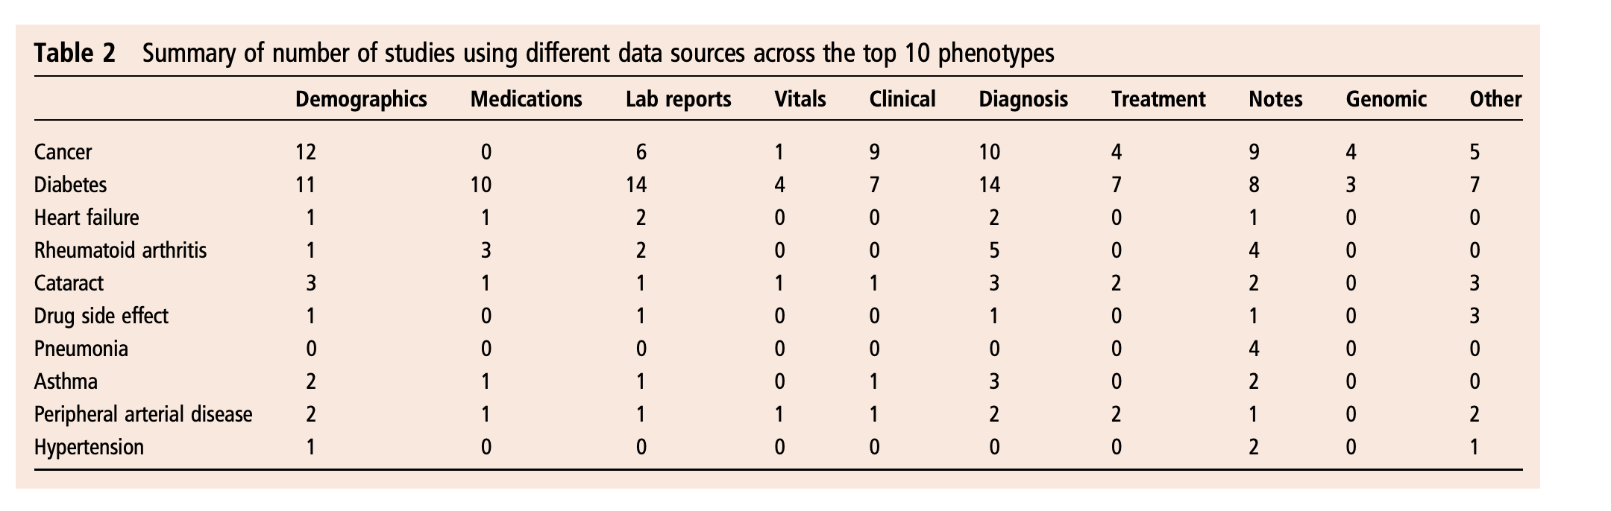
What Data Sources?
https://www.ncbi.nlm.nih.gov/pmc/articles/PMC3932460/pdf/amiajnl-2013-001935.pdf
Notes:
This was a review paper from like 10 years ago but this table still holds up –
Notice that most disease types require pulling data from multiple sources

Slide 37
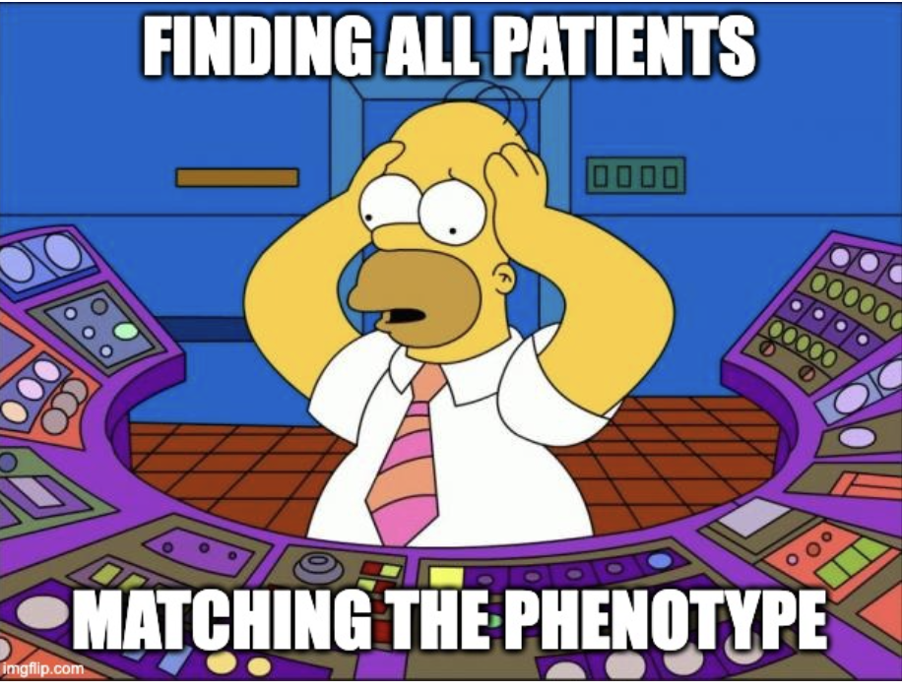

Slide 38
ML-Powered Phenotyping: Case Study 1
Notes:
Now we’re going to look at two approaches that both use ML.

Slide 39
Phenotype: patient has severe covid-19
Gold standard definition: patient wound up in ICU and/or died.
Notes:
Let’s go back to early 2020
To find all matching patients, why not just filter the patient charts for ‘transfer to ICU’ order or an indication that patient died?
(during height of covid, ‘transfer to ICU’ not reliably recorded.)

Slide 40
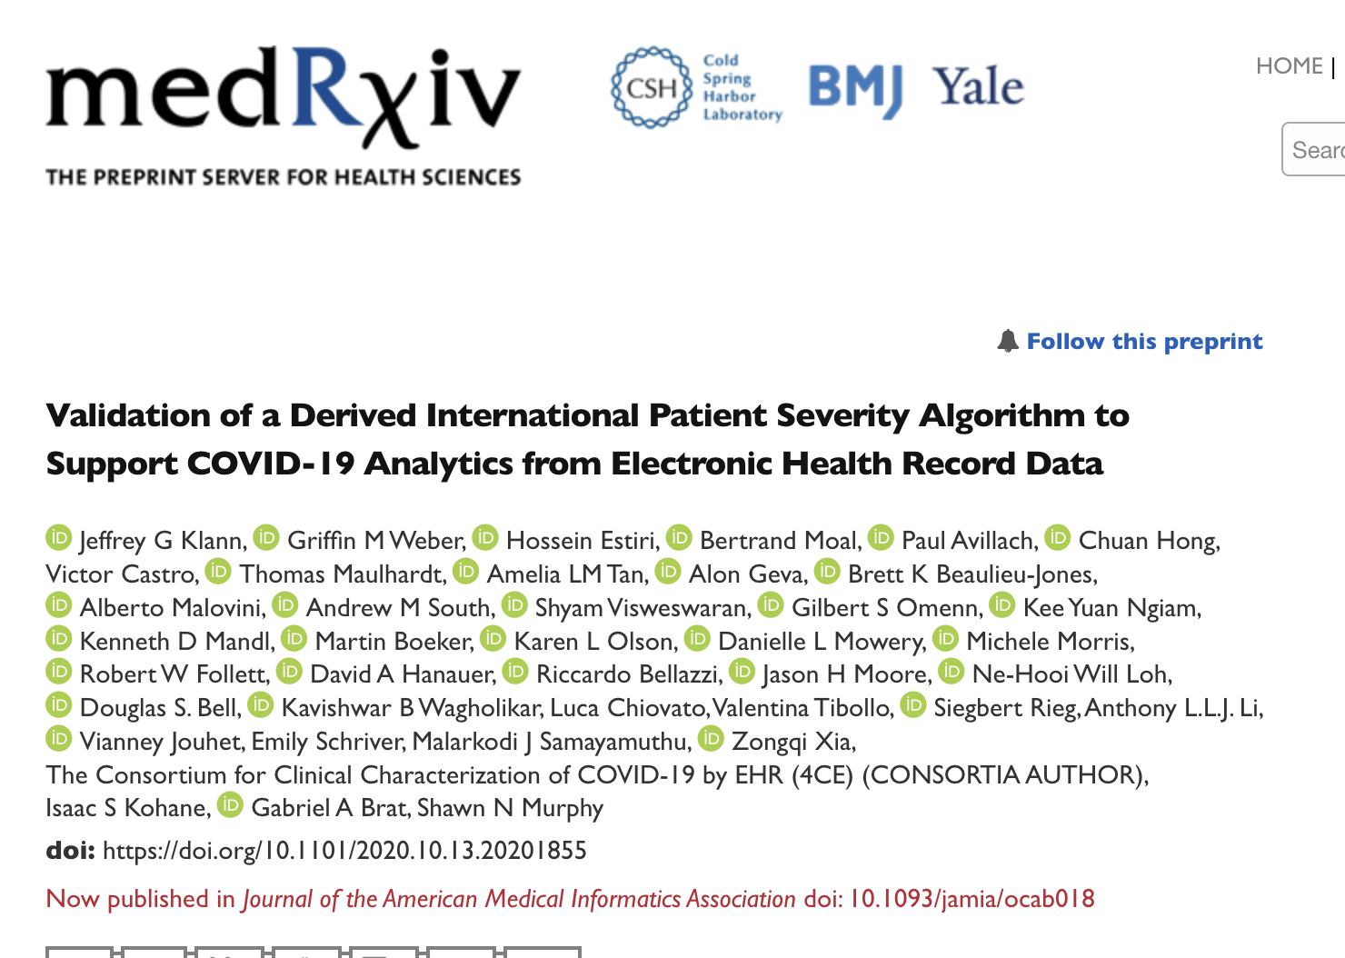
https://www.medrxiv.org/content/10.1101/2020.10.13.20201855v1.full.pdf
Notes:
What is a reliable proxy definition for this phenotype (patient has severe covid)
Consortium for Clinical Characterization of COVID-19 by EHR (4CE): ~300 sites worldwide. Use EHR to study Covid 19

Slide 41
At peak of Covid: 125K new hospitalizations per day
How can we reliably identify severe covid patients automatically, from clinical data?
Notes:
(1) discover a reliable proxy measure
(2) validate with retrospective chart review
Why not just do manual chart review for every case?

Slide 42
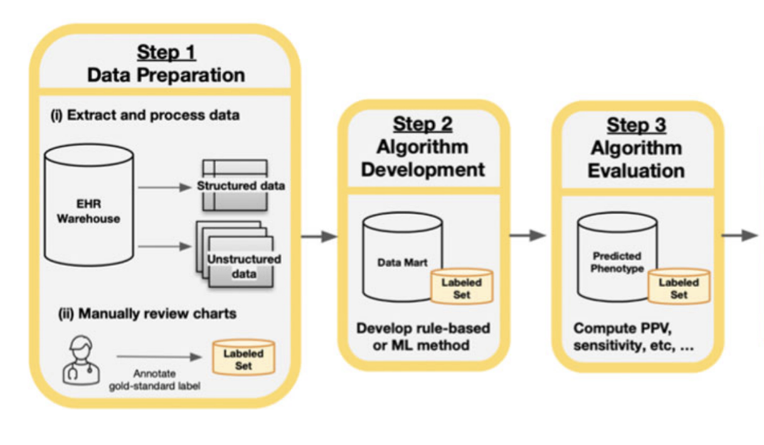
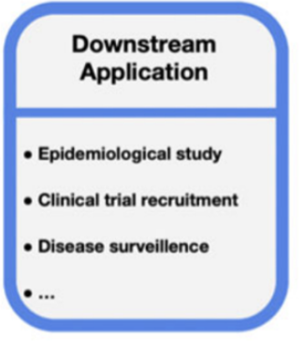
“Classic” Approach
https://academic.oup.com/jamia/article/30/2/367/6839857
Notes:
The *truly classic* (old school) approach is to have a nurse or trial coordinator study the patient charts to identify which patients match the given phenotype.
In the last ~10 years, people have started to apply ML to this.
Here is the standard pipeline.

Slide 43
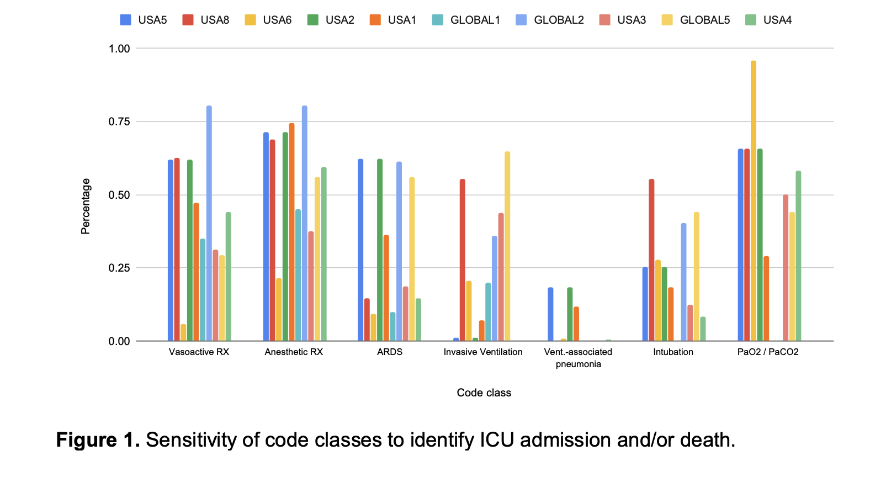
Variance across Hospitals
Notes:
Y-axis: recall/sensitivity (how well does this one code work on recall for death/ICU cases?)
Note variance across institutions for ‘invasive ventilation’ – why?
Coding disparities!
Makes this super challenging
We will discuss this phenomenon more during this course

Slide 44
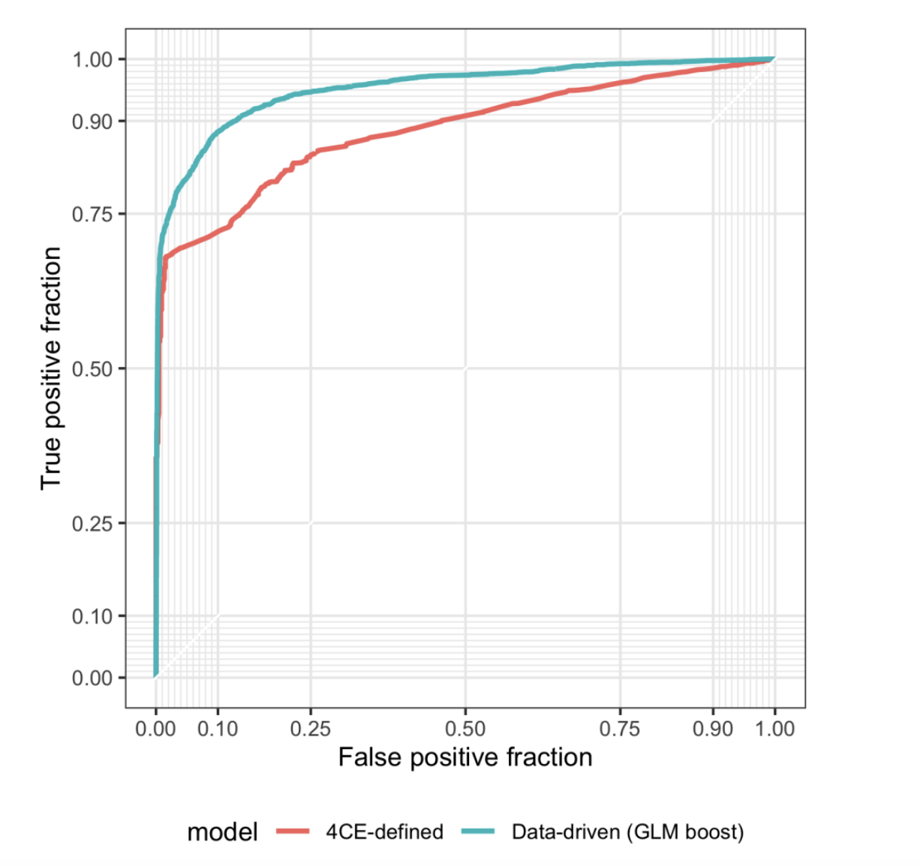
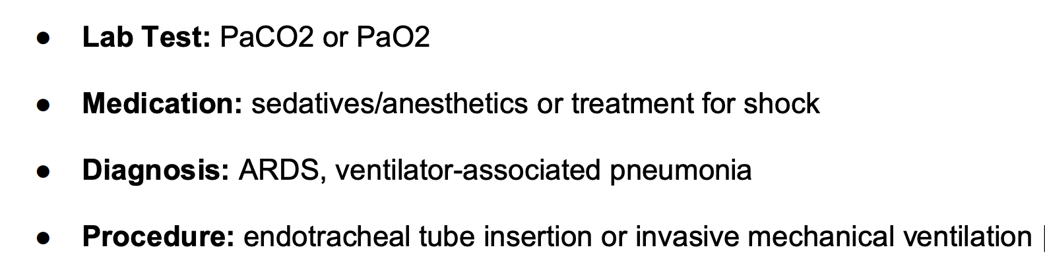
Three Approaches
CPT codes
Expert-driven phenotype
Data-driven phenotype
Notes:
Start with easy approach first. Cf. CPT (billing) codes. This didn’t work – precision/recall as low as 49%
Then ask clinicians to define a phenotype
Then try supervised learning approach (generalizd linear model with regularization)
MSMR: Select a minimal set of codes that have high predictive content. (Basically a form of regularization)
ML Model: GLM, uses gold labeled data as target.

Slide 45
ML-Powered Phenotyping: Case Study 2

Slide 46
Post-Partum Hemorrhage (PPH)
Blood loss of 500 mL or more within the first 24 hours following vaginal delivery, or 1000 mL or more following a cesarean section.
(2-3% of pregnancies and 140K deaths annually.)

Slide 47
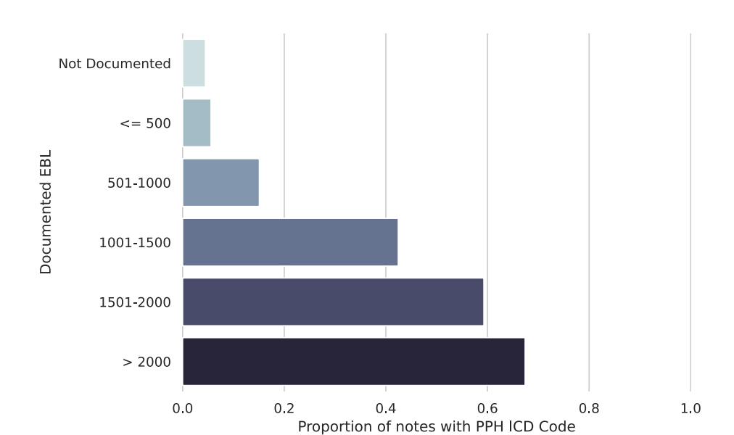
Can we use ICD codes? (072.[0,1,2,3])
Notes:
(ICD 072 = PPH)
What does this graph tell us?
ICD codes are not well correlated: < 50% of notes where EBL> 1L have PPL as an ICD code. (what should that % be?)

Slide 48
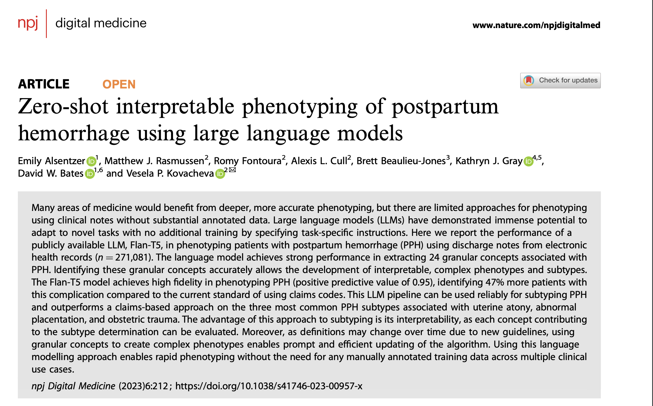
https://www.nature.com/articles/s41746-023-00957-x
Notes:
Very recent paper – 2023
Let’s try throwing an LLM at this problem!

Slide 49
Given some patient charts with ground-truth labeling, how might you use an LLM to identify PPH cases?

Slide 50
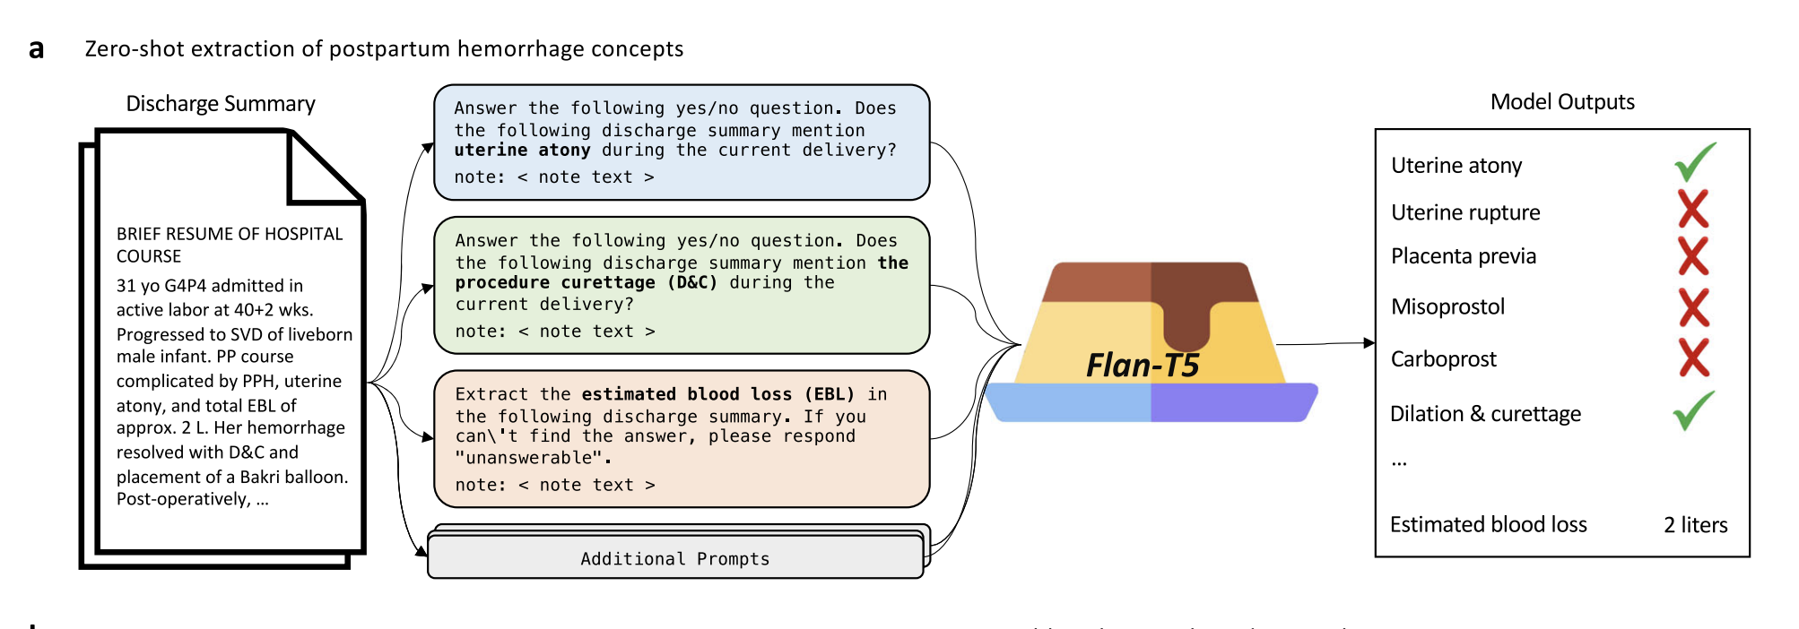
Stage 1: Concept Extraction
Notes:
2 stage process
First stage in pipeline: feed discharge summary to LLM with various prompts.
Result: bit-array

Slide 51
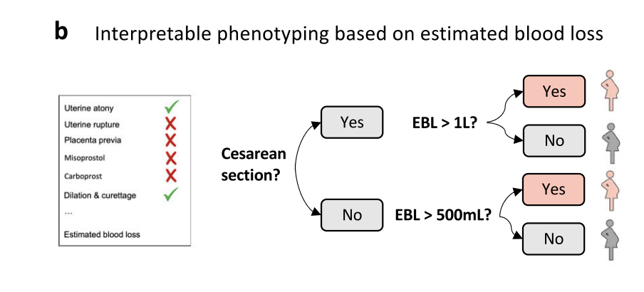
Stage 2: Phenotyping
Notes:
Step 2: combine the Boolean outputs to decide if the patient fits the phenotype – yes/no
Basically just .following the given formal specification of the phenotype

Slide 52
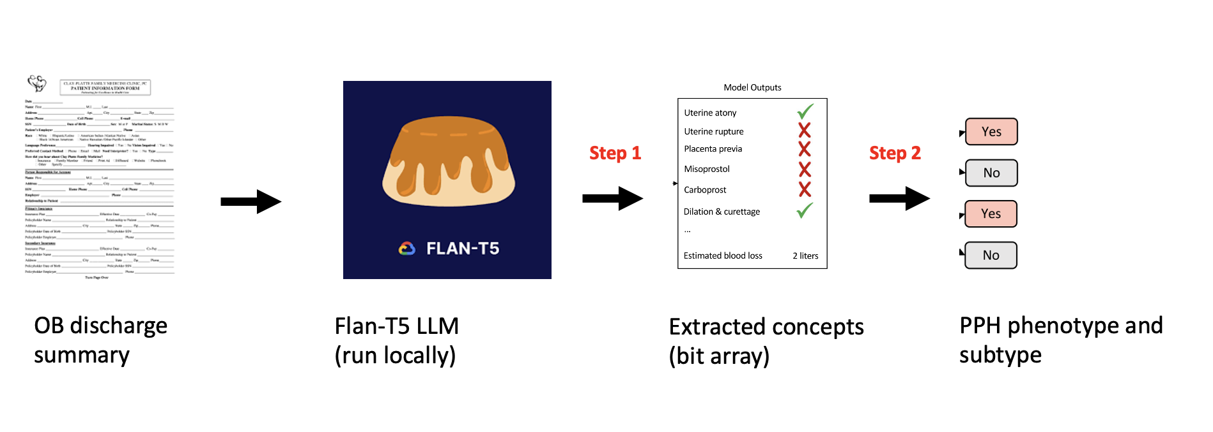
Why bother with a 2-stage pipeline? Why not just throw an LLM at the problem?
Notes:
Why 2 stages? Why not just ask LLM “does this patient have PPH”?
i.e. what’s better about this two-step process?
Hint: think about what I mentioned about working with clinicians (interpretability/explainability)

Slide 53
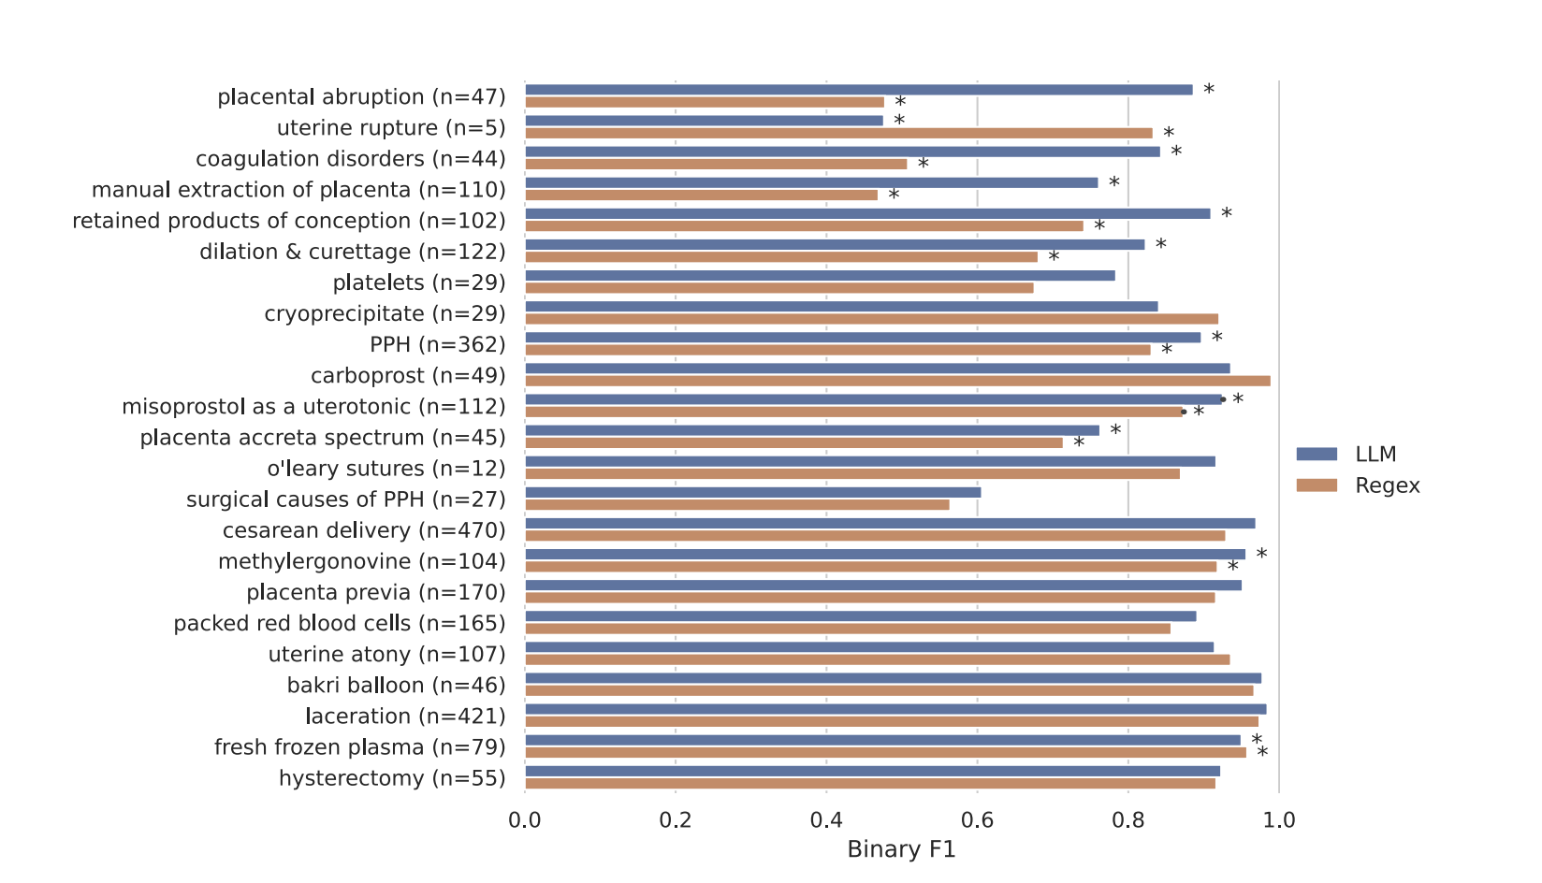
Performance
Notes:
How to interpret this :
Some key phrases that are indicative of PPL. Build a regexp for each to find it, and that’s the pink classifier. Compare w/ LLM (blue)
Why might an LLM outperform a regexp? (“history of” and “denies” and …)

Slide 54
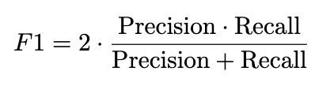
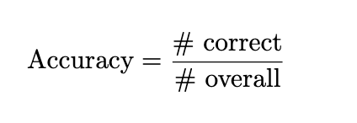
Why F1 Score as the metric? Why not accuracy?
Notes:
Why not use accuracy as the performance metric?
Hint: There might be only a handlful of PPH cases out of a large sample
- accuracy = # instances correctly labeled / all instances
- Class imbalance. You will get a high accuracy just by predicting the majority label.
F1 measure contains recall , so you can’t just always predict the majority (e.g. negative) labek

Slide 55
EOL

